Slide 1
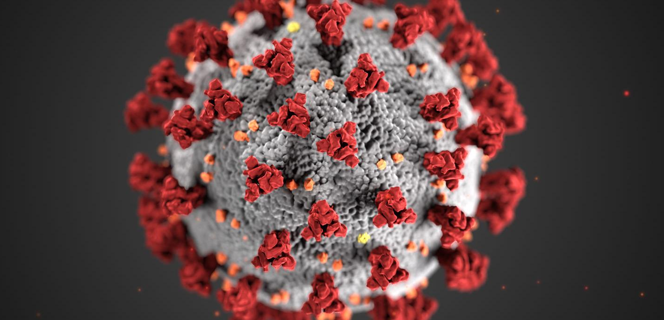


COVIDSCAPE
Team: Last but not least
Aditya Sahu
Gabriel Ore
Shuo Wang Hsu
Wanwiset Peerapatanapokin

Slide 2

Problem Statement
Due to COVID-19, we are now facing risks of contacting the virus whenever we are outside and near other people.
However, what is the actual amount of risk of going to a particular location?
Let's say we want to go Christmas shopping or try outdoor dining for a special occasion. How risky is it to go to location A? What about location B?
COVIDSCAPE seeks to answer this problem by predicting this potential risk

Slide 3
Solution Proposal
COVIDSCAPE’ risk scores are calculated by combining geographical risk scores and effects of personal protective measures such as wearing masks and performing social distancing.
Risk scores and factor are predicted or chosen using official data and medical studies.
In addition, COVIDSCAPE back-traces users who have tested positive and notify other users who may have been in contact with the diagnosed client

Slide 4
COVIDSCAPE Functionalities and Features
User Interface – Web app implementation, available on both desktop and mobile
Risk Score Prediction
Location Risk Score – ML-generated predictions of COVID severity per area, up to 3 days ahead
‘Static’ Risks serve as multipliers to the ML generated score
Notifications
Back trace diagnosed user and notifies possible contacts through email and SMS

Slide 5
COVIDSCAPE Overall Architecture
Node-RED
(hosted on EC2 Ubuntu)
Amazon S3
GPS Sensor
User Inputs
OwnTracks
User ID
Client
(Web App on EC2 Ubuntu)
Server
(Python on EC2 Ubuntu)
Analytic Node (PySpark on EC2 Jupyter)
Daily
Official COVID19 Testing Data
Location
Mask Worn
…
Test Result
User Email
AWS Services for Notification
SNS
SES
User Phone

Slide 6
Server Implementation

Slide 7


Server Implementation - Client & Server Interaction
Establishes a web server utilizing two main libraries:
Python Flask (and Flask-CORS) library to handle HTTP requests from clients
Boto 3: Amazon’s AWS SDK for Python to interface with S3, SNS, and SES
Client sends three types of requests via HTTP GET
User Registration: stores user info and performs email verification
Total Risk Score Prediction by providing necessary user inputs
Aggregates required information, calculates, and returns a Total Predicted Risk Score
Report Diagnosed User
Initiates a backward contact trace on diagnosed user’s history
Notify other users who may have been in contact with the diagnosed user

Slide 8
Server Implementation – Total Risk Score Calculation
Base Score: Location-Based Predicted Risk Score (from input or Node-RED)
Sub-county level risk score is generated by Analytic Node and stored in S3
Server finds the closest region to user GPS location
linear nearest neighbor search using Haversine formula for great-circle distance
Server extracts the risk score for the specific region of the specified day
Multipliers: Individual’s ‘static’ risk factors chosen based on medical studies (obtained via user input).
No social distancing is 4 times more risky than strict social distancing
No mask is 2.86 times more risky than wearing mask
Indoor is 18.6 times more risky than outdoors
Total Risk Score is the Location-Based Risk Score multiplied by the static risk factor scores and finally normalized to between 0 and 1
(Experimental) threshold of >0.2 to indicate user will be in relatively high risk.

Slide 9
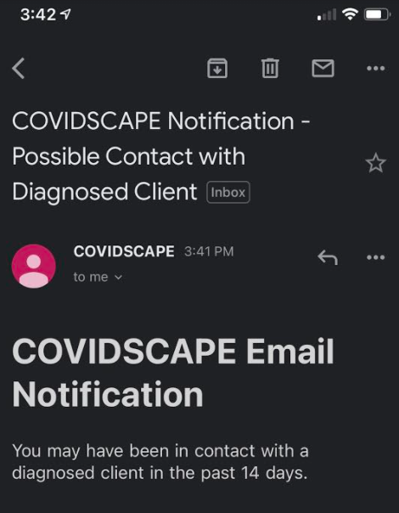
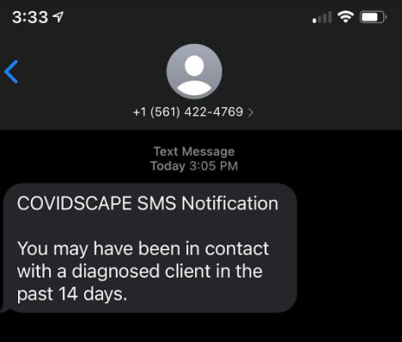
Server Implementation – Back Trace Functionality
Server back-traces diagnosed client for possible contact with others
Users’ location history is built from GPS history collected by Node-RED in S3
Clients whose history data has matching location and timestamps (within tolerances) with the diagnosed client may have contact with diagnosed client
Notifications sent with: Amazon SNS and SES

Slide 10

Differences from Apple and Google’s Exposure Notification
Does not require Bluetooth functionality
Avoids potentially missing devices due to failures to establish Bluetooth connections for various reasons.
Centralized database and computations on the cloud
No additional local CPU, storage, and battery usage
Not dependent on mobile OS version/updates or specific hardware
However it still requires internet connection and a GPS sensor
Does not require high level approval of local health authorities or need local health authorities to create their own applications

Slide 11
LIVE DEMO!

Slide 12

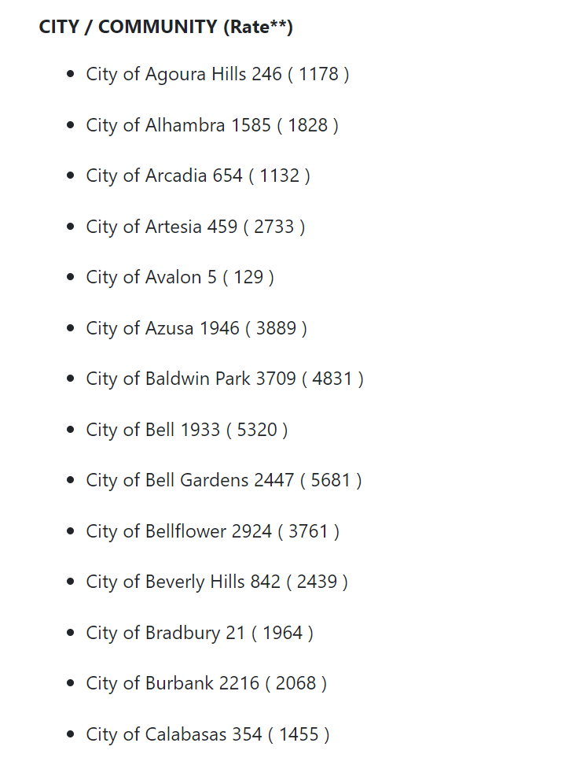
Machine Learning Risk Score
LA County’s Department of Public Health shares daily news update of cumulative city level COVID cases.
They also share normalized ‘rate’ per 100,000 population. This allows us to compare cities of different sizes.
We choose a 14 days concurrent window to represent current COVID patients and use this as the input.

Slide 13

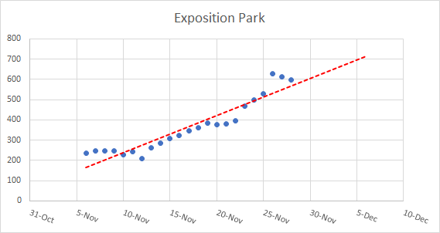
Machine Learning Risk Score
PySpark is used as machine learning framework because of the MapReduce functionality.
We selected to use linear regression model as the machine learning algorithm. This is suitable because we want to predict future data from past trends.

Slide 14
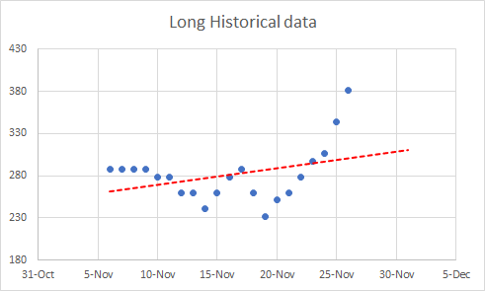
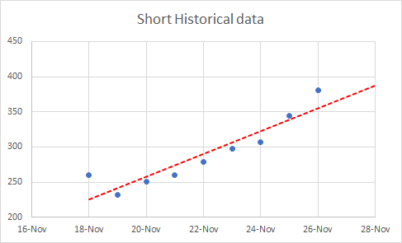

Machine Learning Risk Score
One thing we considered is how many data points to use?
Accuracy is calculated by taking the difference of the predicted value and the actual value that is later provided by LA’s County of Public Health

Slide 15




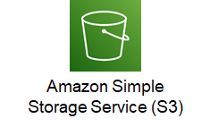

Node-Red Data Collection Implementation
WebHook Relay
EC2
Data Stored on S3
OwnTracks running on mobile devices
Node-RED hosted on EC2

Slide 16

OwnTracks
OwnTracks is a GPS tracking application, which uses open protocols for communication.
Why OwnTracks?
User friendly
Open-source application
Target endpoint can be directly be specified through the settings.
Has multiple configuration for sending the data i.e. manually, periodically, and/or only when the user is moving.
No third-party services are required to send data.
Data sent is encrypted.
Keeps on working in background, and therefore, is power efficient to a certain degree.
Can be configured for MQTT, and other HTTP modes.

Slide 17
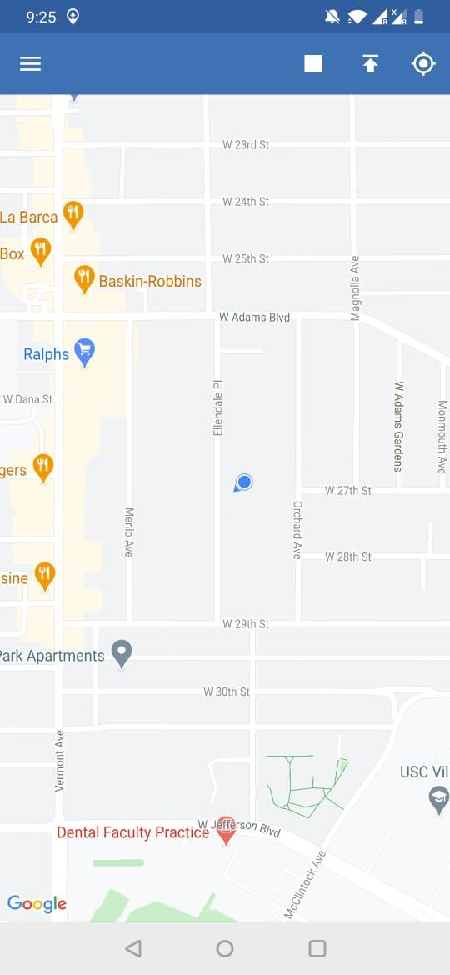
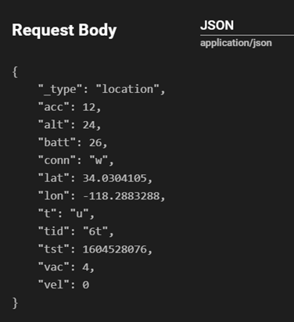
OwnTracks (Contd.)
The data being sent from the OwnTracks is typically in JSON format, which makes it easier to work with.

Slide 18
WebHook Relay
Webhook Relay allows a user to receive, transform webhooks and transmit data without having public IP or configuring NAT/firewall in a secure way. However, we need to setup a bucket to relay the traffic.
Advantages -
Doesn't need separate third-party services like Mosquitto MQTT for data transfer.
Uses internal relays, therefore, the data is secure and encrypted.
Relatively faster because it uses internal relay network for data transfer.
Works in a similar fashion as AWS IoT core.
Has its own flow for Node-RED, hence, tunneling data through WebHook relay to Node-RED is simpler.

Slide 19
Node-RED – AWS EC2
Easier to host Node-RED on a centralized server such as EC2 as compared to hosting and configuring it on multiple mobile devices.
EC2's robust nature and readily accessible resources make it an ideal platform to host Node-RED.
It stores the file generated by Node-RED locally on the EC2 machine. This makes it convenient to "push" the file directly to S3 bucket.
Running Node-RED on EC2 is much more viable as it can remain active all the time.
EC2 instance can be configured to restrict access of traffic from certain or all IP addresses, which layers it with another level of security.

Slide 20
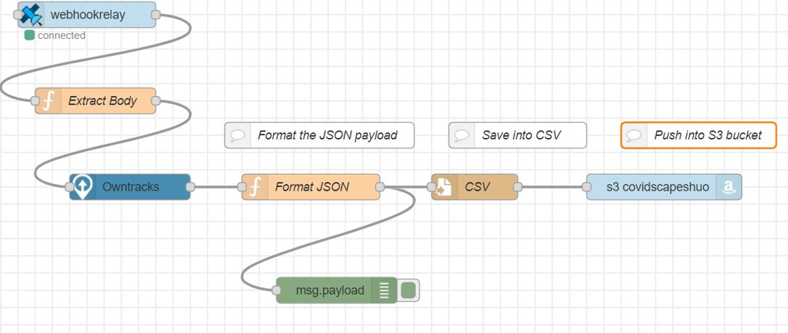
Node-RED Flow (Contd.)

Slide 21
Future Work
User-oriented:
Expand scope to beyond Los Angeles County
Consider additional risk factors for score calculation
Provide additional information and guidance when notifying contact-traced users
Automatically notify user when user enters high risk area
Back-end enhancements:
Server redundancy – enable multiple servers to serve clients more reliably
Database optimizations – use actual databases instead of csv files
Automate Analytic Node – data gathering, running ML, and uploading to server
Address privacy and bad actor concerns
Implement end-to-end encrypted connections (HTTPS)

